Slide 1
Part – I : ANALOG ELECTRONICS
CHAPTER-1: DIODES AND APPLICATONS
Module – 3: Voltage Regulators
Reference:
Robert L. Boylestad, Louis Nashelsky, Electronic Devices & Circuit Theory, 11th Edition, PHI, 2012

Slide 2
Module – 3: Voltage Regulators
Learning Outcomes:
At the end of this module, students will be able to:
Zener diode and its V-I characteristics
Describe the working of Zener as voltage regulator

Slide 3
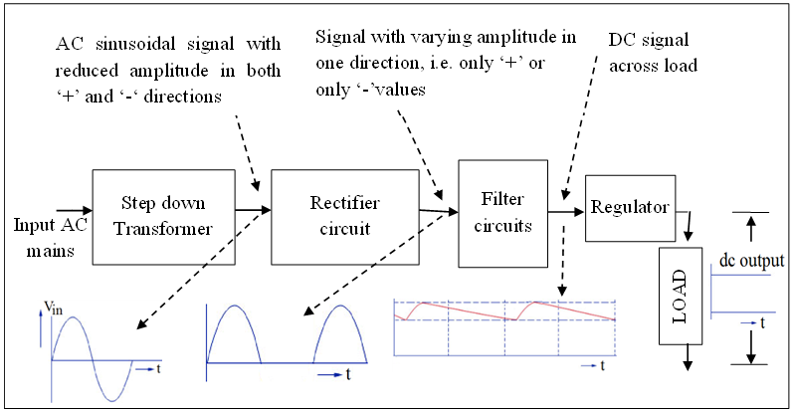
Block diagram of a DC power supply

Slide 4
Zener Diodes
Heavily doped diodes
Used in voltage regulators
Acts like regular diode-forward biasing
Under reverse bias, increase in voltage after Vz causes current to increase sharply maintaining voltage constant
Rated according to the voltage at which they will turn ON or begin to conduct reverse current

Slide 5
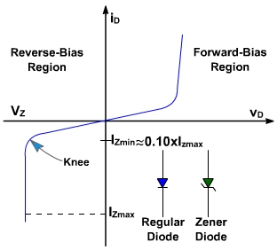
Zener Diode and its characteristics
P
P
N
N
Anode
Cathode
I_{ZK} or I_{Zmin}
I_{ZM} or I_{ZMax}
P_{ZM} or P_{ZMax}
P_{ZM} = V_{Z}.I_{ZM}
Notes:
Zener diode:
Zener diode (also referred as regulated diode) is a two terminal device that is widely used in voltage regulators. When the reverse bias, applied to the semiconductor, has reached to zener voltage Vz , the current will be dramatically increased while the voltage keeps constant.
I_{ZK} or I_{Zmin} – Minimum current necessary to maintain breakdown
I_{ZM} or I_{ZMax} – Maximum current that can be safely passed through the zener diode
P_{ZM} or P_{ZMax} – Maximum power dissipation across zener diode
P_{ZM} = V_{Z}.I_{ZM}
Zener diode is always connected such that it is reverse biased, and it is in zener breakdown region

Slide 6
Equivalent circuit of Zener Diode
Equivalent circuits of Zener diode
Forward Reverse Breakdown
Note: R_{Z} is usually very small, can be neglected

Slide 7
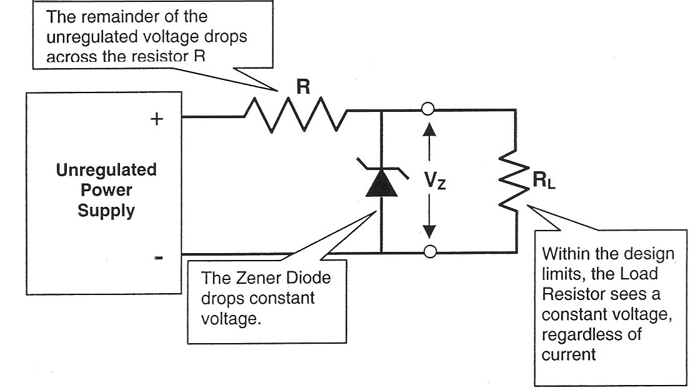
Zener voltage regulation
Notes:
Zener diodes are widely used to regulate the voltage across a circuit. When connected in parallel with a variable voltage source so that it is reverse biased, a zener diode conducts when the voltage reaches the diode's reverse breakdown voltage. From that point it keeps the voltage at that value.

Slide 8
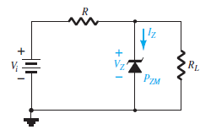
Working of Zener Diode : Vi and R fixed
Determine state of the diode
Use appropriate equivalent circuit
Basic Zener Regulator

Slide 9
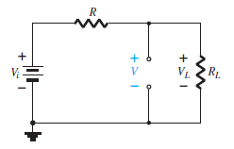

Working of Zener Diode : Vi and R fixed
Determine state of the diode
$V=V_{L}=\frac{R_{L}V_{i}}{R+R_{L}}$
If ${V≥V}_{z}$Zener diode is ON
If ${V<V}_{z}$ the diode is OFF

Slide 10
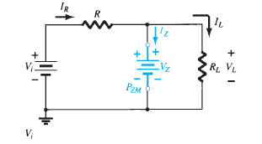

Working of Zener Diode : Vi and R fixed
Equivalent Circuit for ON condition
$V_{L}=V_{Z}$
$I_{R}=I_{Z}+I_{L}$
$I_{Z}=I_{R}−I_{L}$ (Zener Current)
$I_{L}=\frac{V_{L}}{R_{L}}$
$I_{R}=\frac{V_{R}}{R}$ = $\frac{V_{i}−V_{L}}{R}$
$P_{Z}=V_{Z}I_{Z}$ (Power dissipated in Zener diode)

Slide 11

Line Regulation
Fixed $R_{L}$ and variable $V_{i}$

Slide 12
Load Regulation
Fixed V_{i} and variable R_{L}

Slide 13
Numerical Problems
For the zener network, V_{i}= 16 V, R_{S}= 1 K, V_{Z}= 10 V and R_{L}= 1.2 K. Determine V_{o}, I_{Z} and P_{Z}
Repeat with R_{L}= 3 K
(Ans:: 8.73 V, 0, 0)( 10V, 2.67mA, 26.7mW)

Slide 14
3. In a zener network, R_{S} = 120Ω, R_{L} = 250Ω and V_{Z} = 5V. Find the minimum and maximum current flowing through zener when input varies from 9V to 15V.
(Ans: 13.33mA, 63.33mA)

Slide 15
4. For the Zener network shown, R_{S} = 10Ω, V_{Z} = 10V, V_{i} = 25V. Find the minimum and maximum current through Zener when R_{L} is varied between 10Ω and 100Ω
Ans: (0.5A,1.4A)

Slide 16
For a zener network, R_{S} = 470Ω, V_{Z} = 12V and V_{i} = 50V. Find the minimum and maximum values of R_{L} so that Zener diode remains in ON state, given that I_{ZK} = 2 mA and P_{ZM} =500mW
(Ans: 152 -306 ohms)

Slide 17
6. In a Zener regulator, the input DC is 10 V ± 20%. The output requirements are 5 V, 20 mA. Given Izmin=5 mA and Izmax=80 mA. Design the Zener regulator.
( Ans: R_{L}=250 Ω, V_{inmin}=8V , V_{inmax}=12 V, R_{max}=120 Ω , R_{min}=70 Ω.)

Slide 18
7. (a) Consider the circuit shown below.
The Zener Diode regulates at 50V over a range of diode current from 5 mA to 40 mA. Supply voltage V = 200V. Calculate the value of R to allow voltage regulation from a load current I_{L} = 0 upto Imax; the maximum possible value of I_{L}. What is Imax? (Ans: Imax=35 mA)
(b) If R is set as in part (a) and I_{L} = 25mA, what are the limits between which V may vary without loss of regulation in the circuit?
(Ans: Vmin=162.5 V, Vmax=293.8 V )

